Slide 1
OZTECH
PRESENTATION 4

Slide 2

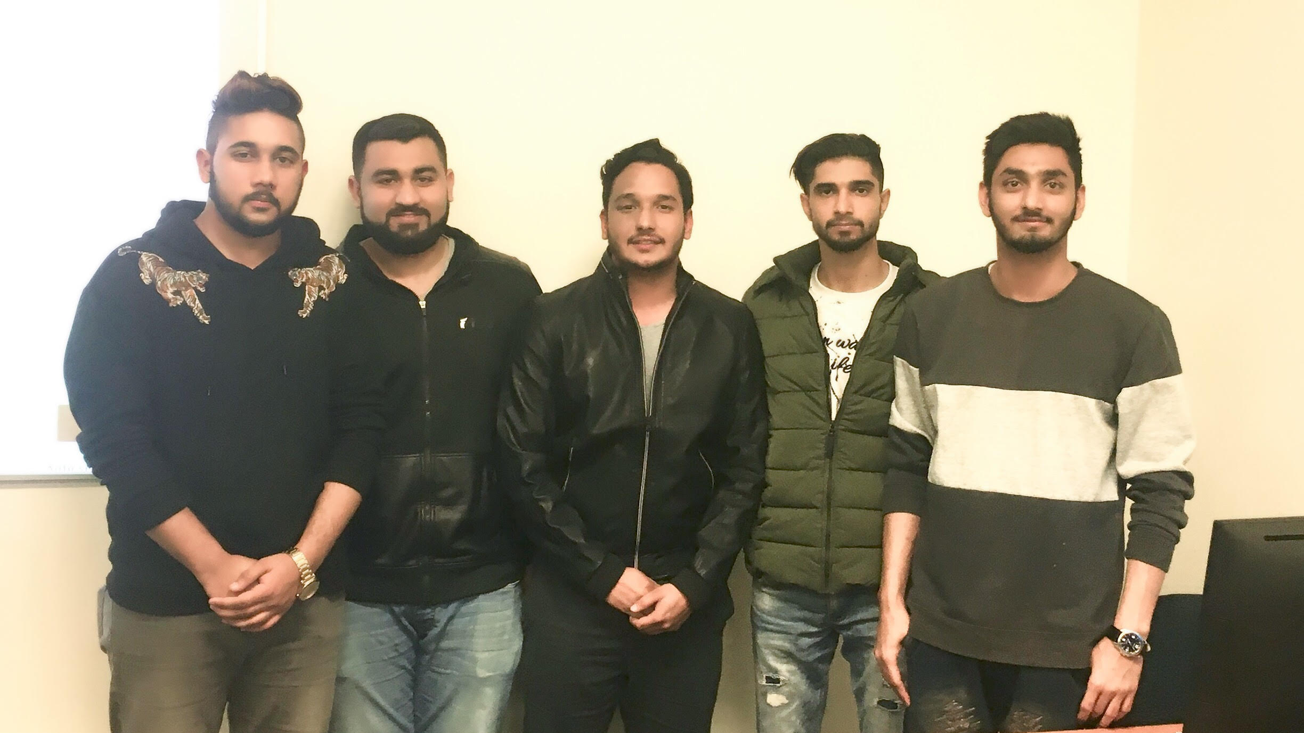
Oz tech-A CREATIVE TEAM
Anmol Batish Project Manager, Programmer
Paras Joshi Programmer, designer
Diljot Singh Database
Inderjeet Singh Documentation, Assistant project manager
Muhammad Asfand Version control, Testing

Slide 3
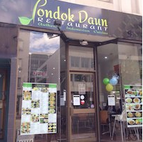

Client
Well known Indonesian restaurant located in the heart of Adelaide.

Slide 4
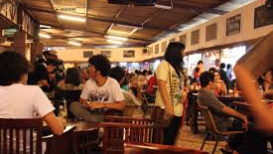
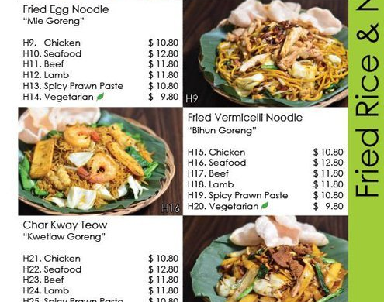
PONDOK DAUN
Authentic Indonesian cuisine
Located in the east end of Adelaide.
It serves a seasonally evolving menu with daily specials.
Sibling of Restaurant Orana.

Slide 5
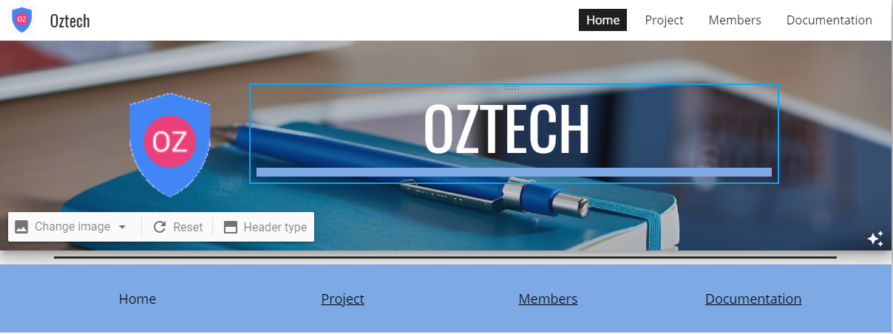

TEAM SITE

Slide 6
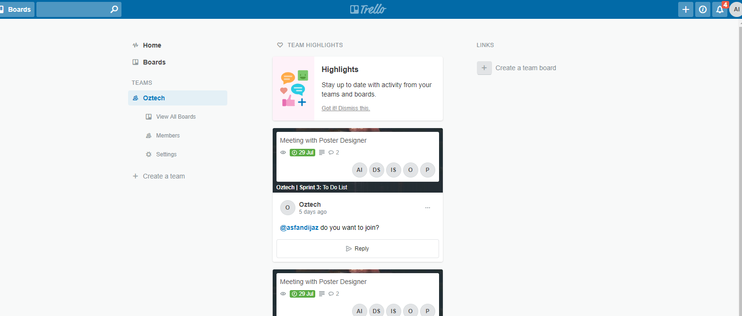
PROJECT MANAGEMENT TOOL
TRELLO

Slide 7
FUNCTIONALITIES for user
View Products
Order & Update Details
Login
Booking
Review
Specials
Catering
Give Feedback
Contact Form
View Restaurant location.

Slide 8
Functionalities for admin
USER ORDER FORM
ADMIN LOGIN/LOGOUT
VIEW BOOKINGS FOR ADMIN
VIEW CATERINGS FOR ADMIN
View Daily Sales Report
View Weekly Sales Report
View Monthly week Reports
View Confirmed Orders

Slide 9
NEW FUCTIONALITIES ADDED in Sprint 3
USER ORDER FORM
ADMIN LOGIN/LOGOUT
VIEW BOOKINGS FOR ADMIN
VIEW CATERINGS FOR ADMIN

Slide 10
Functionalities added in sprint 4
View Daily Sales Report
View Weekly Sales Report
View Monthly week Reports
View Confirmed Orders

Slide 11

Sprint 4 Client Meeting
Client contact person is changed.
Now Dealing direct with owner whose name is Sargono.
Demonstrated sprint 4 items to client.
Showed him admin functionalities.
Talked about the menu specials.
Meeting went well.
Communicated through email as well

Slide 12
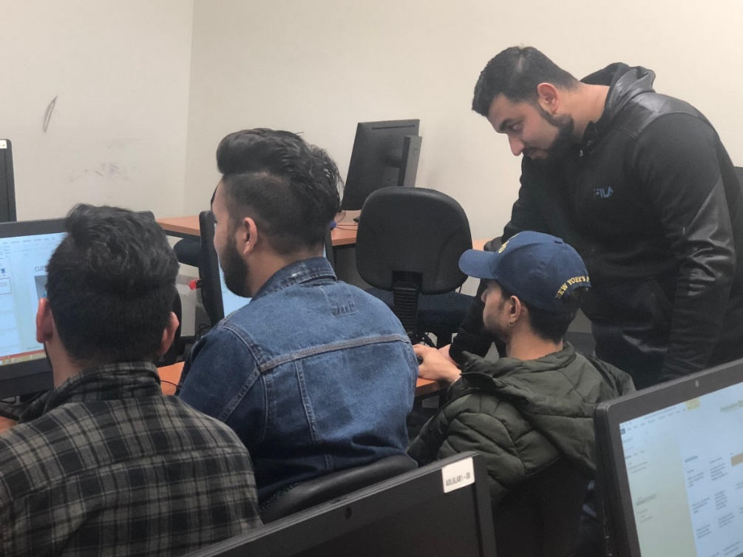
Sprint 4 Group Meeting
Meetings held in lab.
Developers and Programmers help each other as well.
Each Member worked at it’s Peak.
Discussed about tasks of each other.
Raised our concerns about the completion of project.

Slide 13


STANDARDS
Google Drive
Data Accessing
Team Meeting Site
Data Interchanging
Version control
Change control
Communication control

Slide 14
Standards
Data Accessing and Version control is done with the help of google drive.

Slide 15
Change control
Change control
Using agile methodology and scrum methodology
Helps to change at any stage of project.
Easy to use
Quite effective

Slide 16



Communication control
Communication has been done via emails and whatsapp.
Easy for us to use that.
Everybody responses on time.
No communication problems at all.

Slide 17
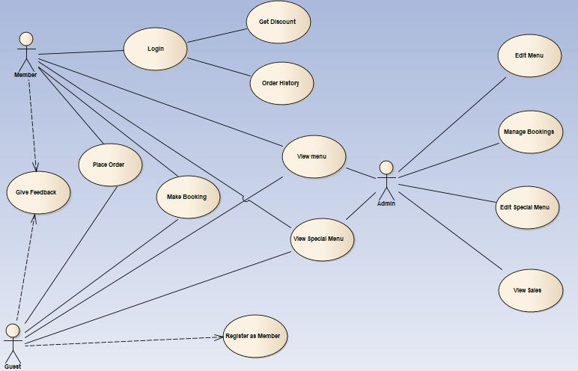
Use Case Diagram

Slide 18
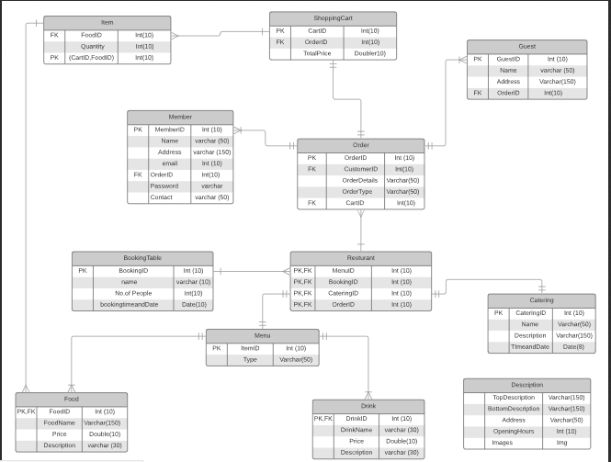
ER DIAGRAM

Slide 19
DATABASE & WORKING FUNCTIONALITY

Slide 20


